Slide 1
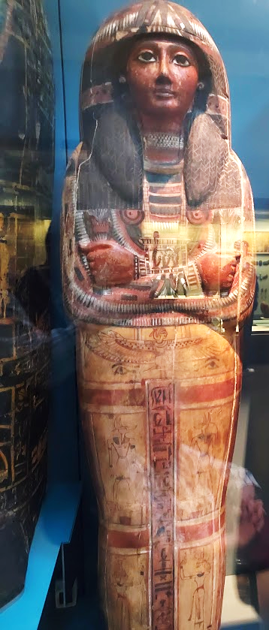
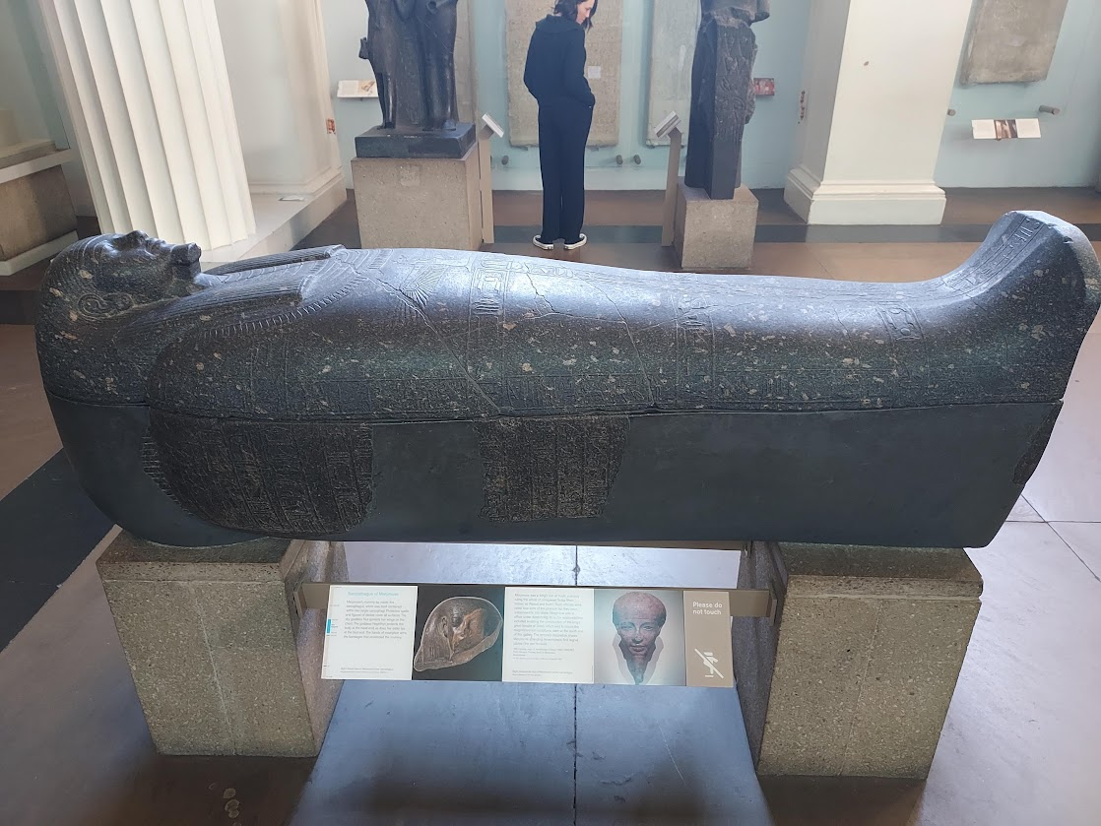
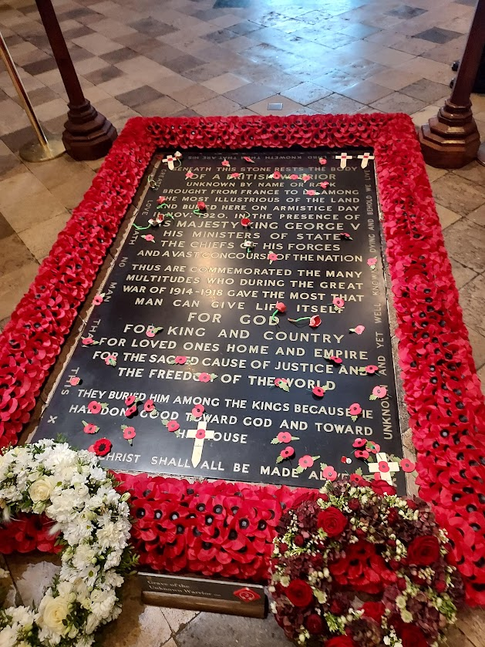
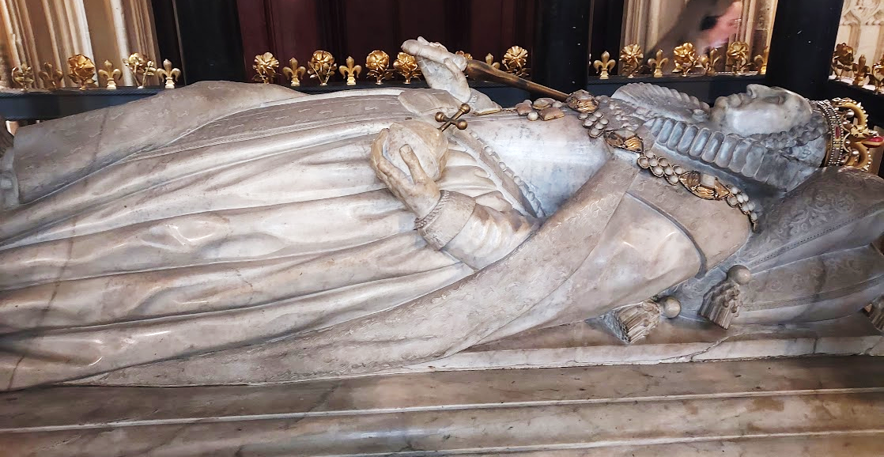
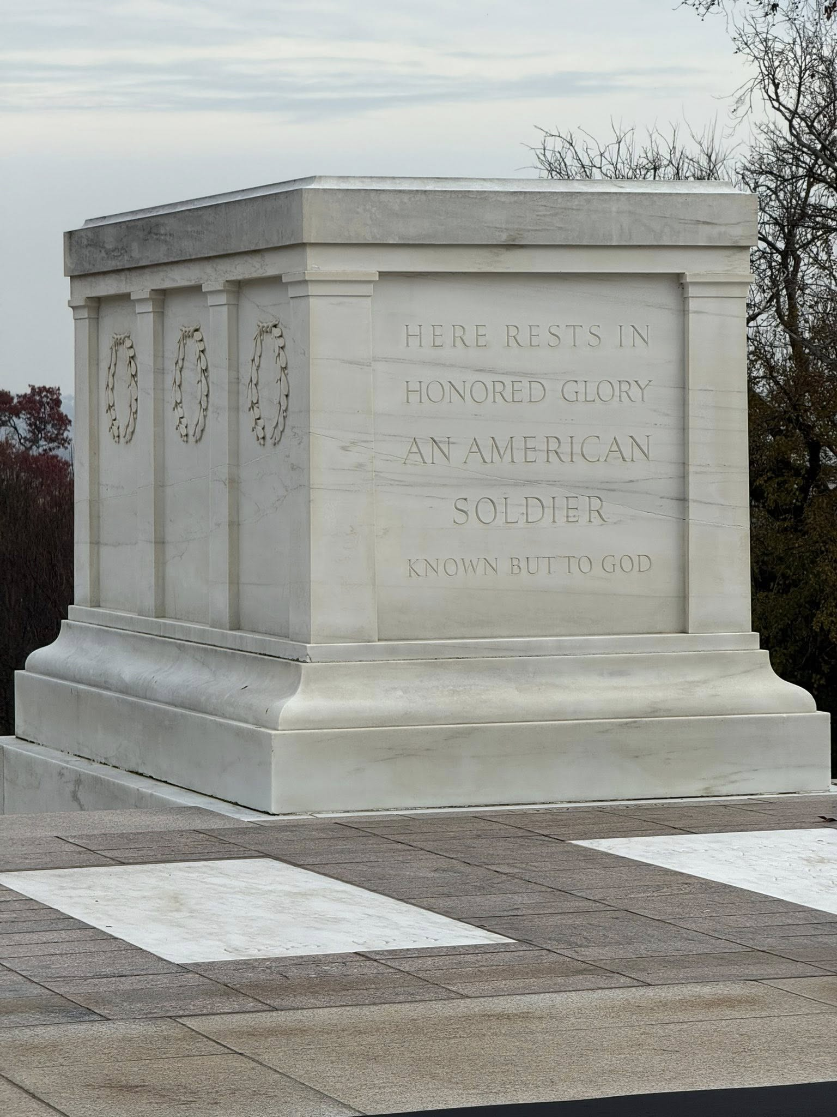
If a Man Dies, Shall He Live Again?
(Job 14)
Notes:
Job suffered severely in life. Life was hard and death was inevitable; but was there life after death that was worth hoping for? Yes. God desires the work of His hands. He wants us back in the pristine condition He created us.

Slide 2
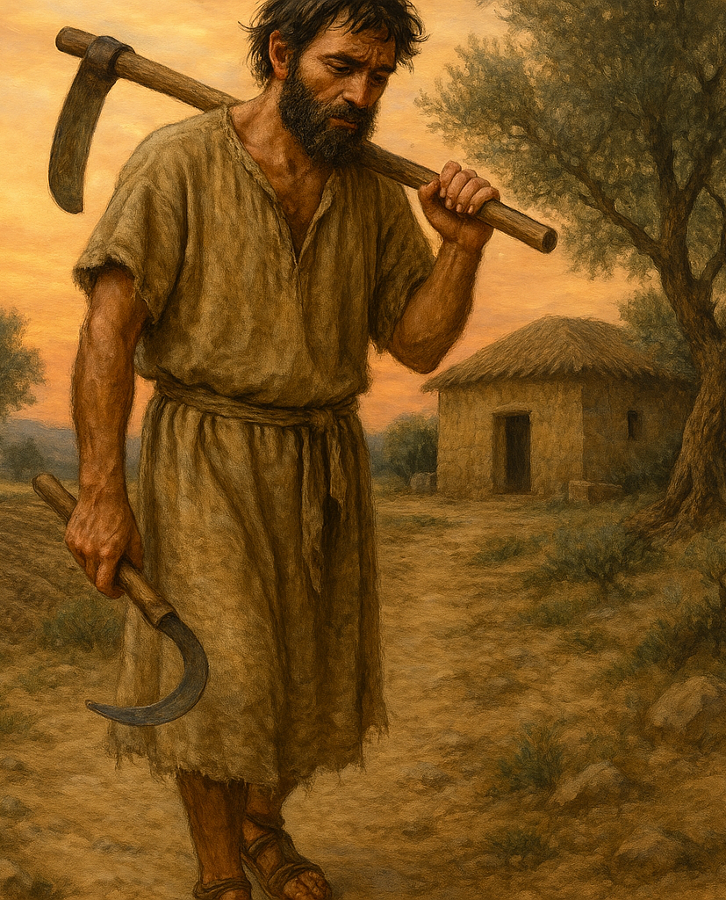
The Brevity and Travail of Life
Mans’ days are short (Job 14:1-2; Psalm 90:10).
Yet God may judge and punish him even in this life (Job 14:3-6).
Job desires to live and die in peace.

Slide 3

When Life on Earth is Over, It’s Over! (Ecclesiastes 9:5-6; Job 14:7-22)
Man is not like a tree that can be cut down and come back to life (Job 14:7-8).
When man dies, he is laid away (Job 14:9-12).
Hope is washed away and eroded because death appears permanent (Job 14:18-22; Heb. 9:27; Eccl. 12:1-8)

Slide 4
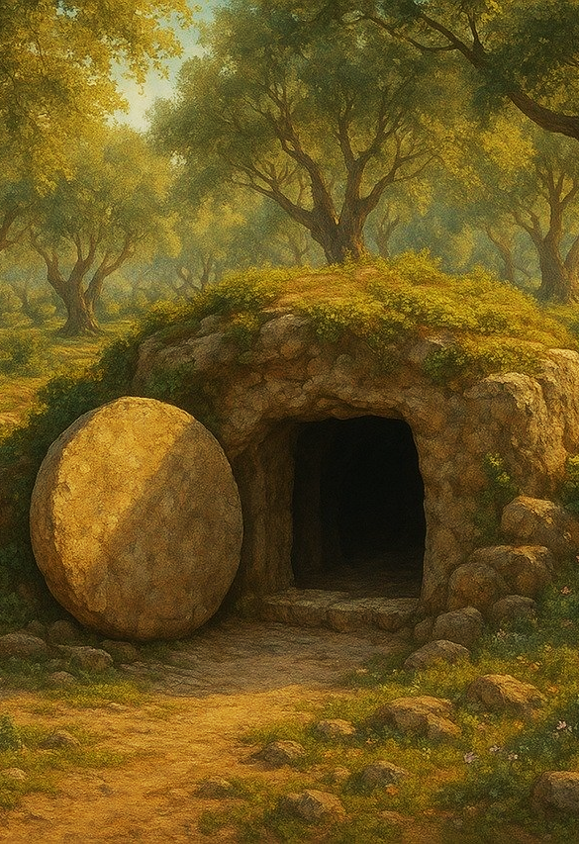
If a Man Dies, Shall He Live Again? (Job 14:13-15)
Job answers his own question (Job 14:15; 19:26-27).
Jesus and Paul give the same answer (John 11:25; 1 Cor. 15:52; 1 John 3:2; Phil. 3:20-21).
God will desire the work of His hands (Romans 8:19, 23; 2 Cor. 5:4-8)

Slide 5
God Wants You Back!
He wants you back in the condition you were in when He created you – in His image!
In Christ, we “have put on the new man who is renewed in knowledge according to the image of Him who created him.” (Colossians 3:10)

